Slide 1
CS/SE 611 Secure Web Design
Professor Lozada
7:30-10:20PM

Slide 2
Agenda
Roll call
Class Introductions
Syllabus Overview
Information Security Overview
Data Breaches
Web Application design overview
Hosting Infrastructure

Slide 3
Information Security
What is Information Security?
Information Security is the body of technologies, processes and practices designed to protect networks, computers, programs, smartphones/tablets and data from attack, damage, modification, loss or unauthorized access.

Slide 4
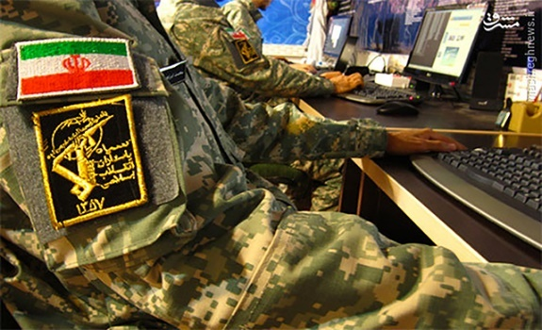
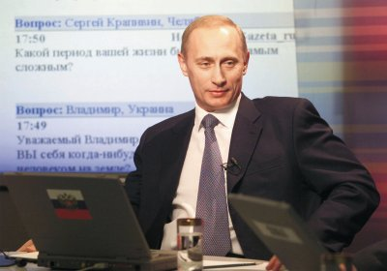
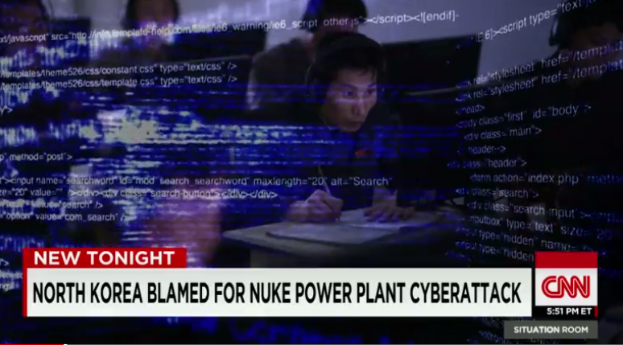
Cybersecurity Around Us
Nation State Threat Actors
As identified by the Director of National Intelligence, Daniel Cotes, in the 2022 Worldwide Threat Assessment.
Iran
Russia
China
North Korea
Notes:
China:
Iran: Revolutionary Guards’ Cyber Attacks Now Directed at Rouhani Cabinet Members (2016)
Russia: Russia: 7-year cyberwar against Nato, EU and US by Kremlin-sponsored hackers The Dukes exposed (2015)
North Korea: http://www.cnn.com/videos/world/2015/03/17/tsr-dnt-todd-north-korea-nuclear-plant-cyberattack.cnn

Slide 5
Information Security
Why This Matters
Security is NOT JUST a feature
The responsibility to protect data
Regulatory/ Legal mandates (i.e., HIPAA, GDPR, PCI, PII, EU Privacy and CCPA). Research CCPA
Contractual bindings
Corporate Policies
Data breaches are expensive
Notes:
Cyber attacks cost the average American firm $15.4 million per year.
* The total global cost of data breaches in 2016 was $460 billion.

Slide 6
Information Security
What is a Data Breach?
A Data Breach is any incident which results in unauthorized access of data.
In the event or an data breach, companies would be legally required to notify potentially affected individuals of the breach.
Notes:
Ask how security Breaches are possible?
Examples: passwords shared, shoulder surfing, lost paperwork, lost device, staying logged in
Notice: I didn’t say “getting hacked”

Slide 7
Top Data Breaches 2022 Continued
https://www.securitymagazine.com/articles/91366-the-top-12-data-breaches-of-2019
Research time - 10 – 15 Minutes

Slide 8
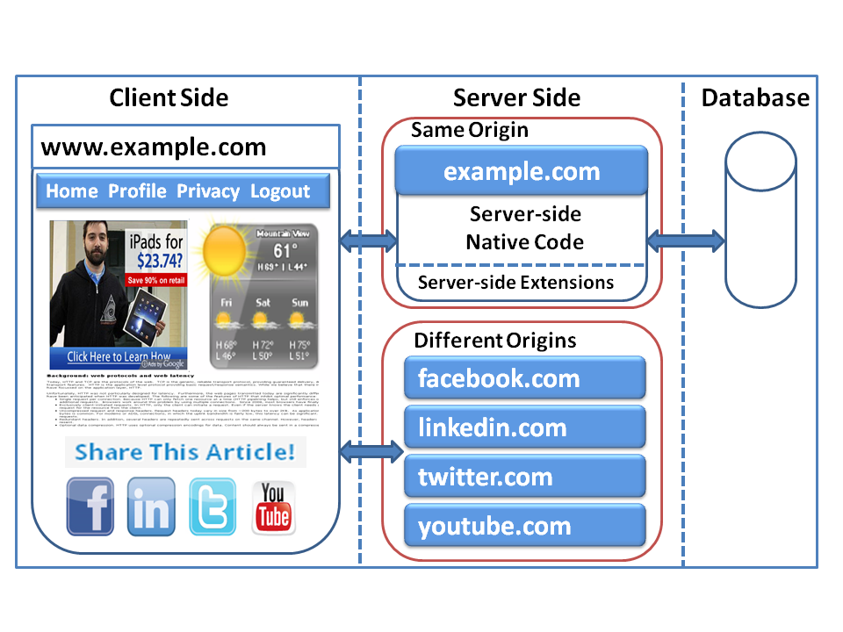
A Web Application Example

Slide 9
Current Access Control Systems
Web Browser
Web Application Server
Database
HTML Page
Server-side Code
(PHP, C#, Java Servlet)
SQL
Code
Static Contents
JavaScript Code
DB Access Control
Browser Access Control (SOP)
Session + OS Access Control

Slide 10

Same Origin Policy (SOP)
Google Mail
www.gmail.com
DOM Tree
JavaScript
Code
AJAX
AJAX
www.microsoft.com
(this action is now allowed)
Cookies from
Gmail.com
Cookies from
Microsoft.com
Notes:
Document Object Model is the way JavaScript sees its containing HTML page and browser state.

Slide 11
Same-Session Policy
After authentication, a session is established
Avoid repetitive authentication
Session cookies: authentication token
Same session, same privileges

Slide 12
Problems of SOP and SSP
Coarse granularity: one or nothing
No separation of privileges
Do we need to separate privileges?

Slide 13
Application-Specific Logic
Web Browser
Server-Side Access Control
Database
HTML Page
Application-specific
Access Control
Static Contents
SQL
Code
Browser-side Access Control
Database-side Access Control
JavaScript Code
DB Access Control
Browser Access Control (SOP)
Session + OS Access Control

Slide 14
Inadequate Access Control
Access control has to be built into program logic
Not easy for programmers
83% of web sites have at least one serious vulnerability
Deploy countermeasures in programs.
Developers need to be security experts
Do we have enough security experts?
I am a security expert, I am afraid of writing web apps.
Something is fundamentally wrong!
Don’t blame the developers
Blame the Web’s security infrastructure

Slide 15
Build Better Access Control
Web Browser
Server-Side Access Control
Database
HTML Page
Application-specific
Access Control
Static Contents
SQL
Code
JavaScript Code
Browser-side Access Control
Database-side
Access Control
Better Access Control
Better Access Control System
Better Access Control System

Slide 16
The Benefit
Developers’ security efforts are reduced
They only need to “configure”
Enforcement is done by the system
Configuration: compared to Implementation
Much easier to do
Require less security expertise
Less error prone
Easier to verify

Slide 17
Security Engineering Principles
[Saltzer and Schroeder 1975]: 8 design principles for building protection systems:
Economy of mechanism
Fail-safe defaults
Complete mediation
Open design
Separation of privilege
Least privilege
Least common mechanism

Slide 18
Harding Infrastructure Discussion
Anti-Virus
Firewalls
Web-Application Firewalls
HTTPS – End to End Encryption
IDS / IPS – Intrusion Detection vs Intrusion Prevention
Container Security
Logging
Research AWS and GCP

